Slide 1

Sentiment Analysis
for Movie reviews
By Group No. 6-
Anindita Sarmah
Sanika Dhawale
Ariba Surani
Mayuri Jadhav

Slide 2

What is Sentiment Analysis?
Sentiment analysis is a technique in natural language processing that seeks to detect and extract the emotions and viewpoints conveyed in a text, such as reviews, social media posts, or news articles
The process entails utilizing machine learning algorithms to analyse the language and establish the sentiment, which can be positive, negative, or neutral
It comprises a series of steps, including text pre-processing, feature extraction, and classification
Text pre-processing involves preparing and cleansing the text for analysis. Following that, feature extraction identifies pertinent elements, such as words or phrases, that assist in determining the sentiment. Finally, classification is executed using a machine learning algorithm to categorize the text's sentiment
Sentiment analysis finds application in several areas, including social media monitoring, market research, customer feedback analysis, and political analysis

Slide 3

Benefits
Understanding customer sentiment: Sentiment analysis enables businesses to gain insights into customer sentiment, such as their preferences, likes, and dislikes, by analysing customer feedback, reviews, and social media posts
Market research: Businesses can obtain valuable insights into market trends, preferences, and sentiment by analysing the sentiment of their target audience, which can aid them in making informed decisions regarding product development, advertising, and marketing strategies
Competitive analysis: Businesses can adjust their strategies based on insights gained from monitoring the sentiment of their competitors, including identifying their strengths and weaknesses

Slide 4


Problem Statement
Develop a sentiment analysis model that can classify movie reviews into positive, negative, or neutral sentiment categories.
This process involves collecting a dataset of labelled movie reviews, pre-processing the data to eliminate noise, selecting a suitable machine learning algorithm, training the model on a training set, and evaluating its performance using various metrics.
The aim is to create a highly accurate model that can predict the sentiment of new movie reviews with confidence

Slide 5





Data Source and Data Preparation
The data for this project is found from kaggle.com Kaggle Dataset link
train dataset : imdb_reviews.csv
test dataset : test_reviews.csv
csv for word embedding : word_indexes.csv
Data Preparation-
Numpy
Pandas
Pyplot from Matplotlib
Word embedding

Slide 6

1. Preprocess the data 2. Word Embedding 3. Defining the model architecture 4. Training the model 5. Testing the model
Overview of the Steps Involved

Slide 7
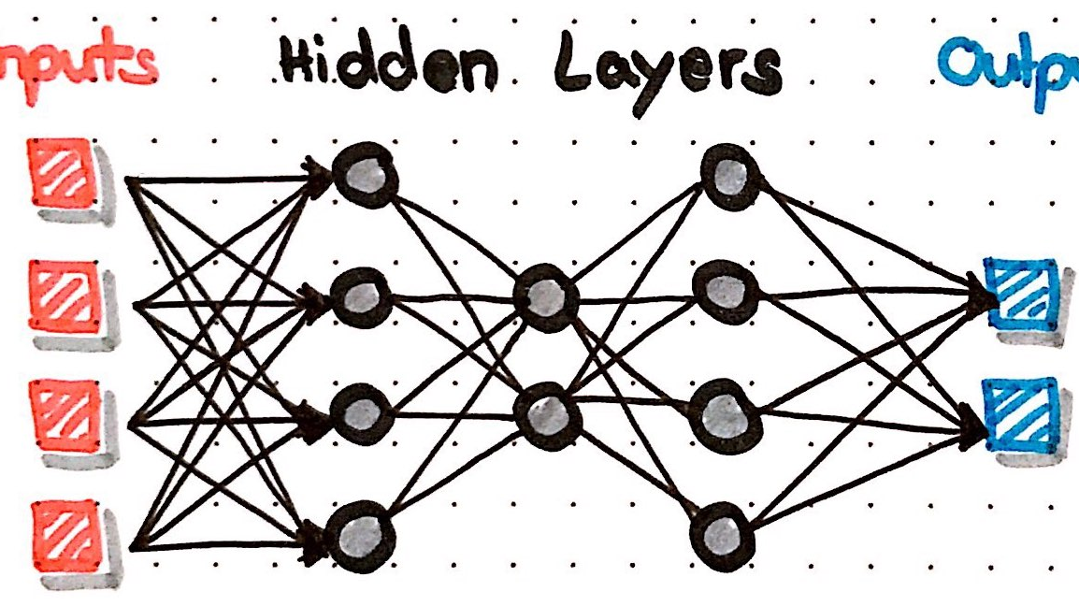

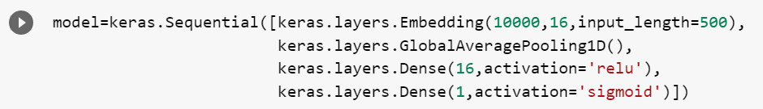
Modelling
Data Model: Neural Network - KERAS
Keras is an open-source deep learning library written in Python that allows users to easily build, train, and deploy neural networks. It provides a user-friendly interface for defining and configuring various types of neural network architectures, including convolutional neural networks (CNNs), recurrent neural networks (RNNs), and multi-layer perceptrons (MLPs).
This Photo by Unknown author is licensed under CC BY-NC.

Slide 8
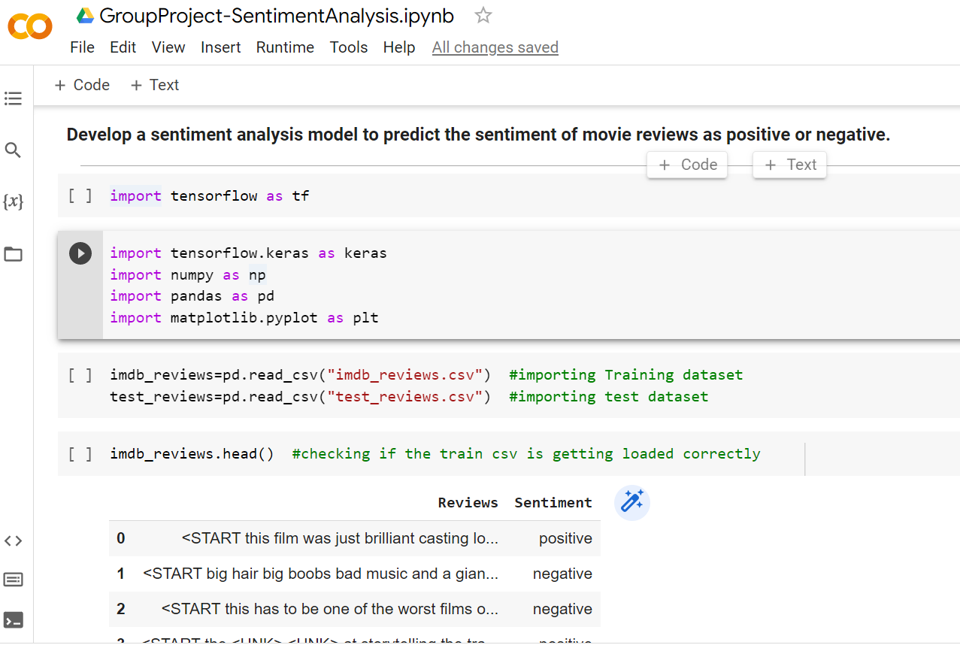
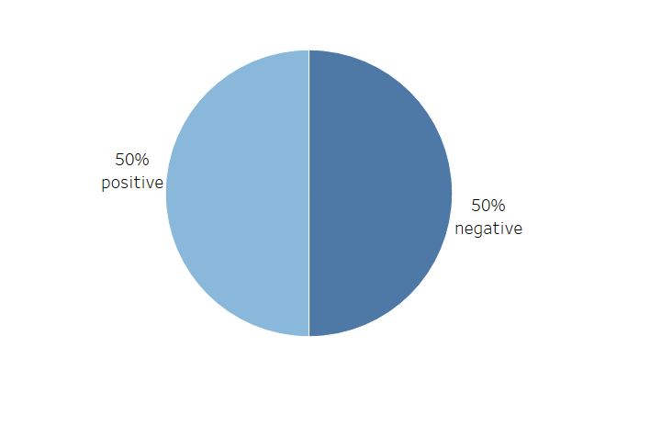
Evaluation

Slide 9

CONCLUSION
To conclude our dataset has been trained to predict the sentiment of movie reviews with an accuracy of 94%. This indicates that the algorithm is able to accurately classify 94 out of every 100 reviews correctly.
However, when tested on a separate set of data, the accuracy of the algorithm drops to 88%. While this is still a relatively high level of accuracy, it suggests that there may be some limitations to the model's ability to generalize to new data.
Therefore, it may be necessary to further refine the algorithm to improve its performance on previously unseen data.

Slide 10

Thank You!
This Photo by Unknown author is licensed under CC BY-ND.

